Slide 1

THE GREEN LIFE
Sentiment Analysis
Using Machine learning
Of Iphone 4s
P123 - Group 2

Slide 2



Meat our Team
Aishwarya Mate
Pooja Anil Patil
Prity Bansod
Gayatri Bansod
Vaishali B Uddewal
Pradeep Sharma
Prasad Kyatham

Slide 3
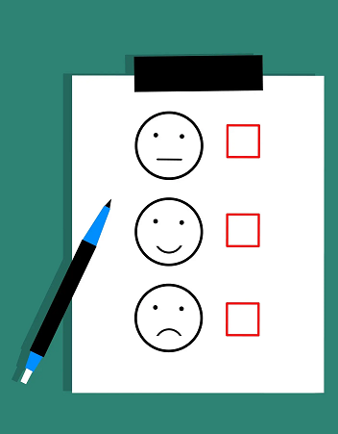
Introduction
Our Project Sentiment analysis using Machine learning, is an important area in Natural Language Processing(NLP), that is the process of automatically detecting affective states of text. Sentiment analysis basically refers to analyzing an opinion or feelings about something using data like text or comments or articles. So knowledge base approach along with machine learning approach are the two strategies used for analyzing sentiments from the text. We have developed a Sentiment Analysis Model trained using Sentiment dataset with machine learning that allows computers to learn new tasks without being expressly programmed.

Slide 4
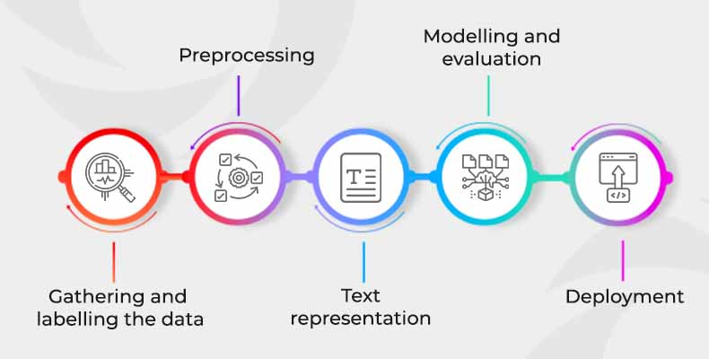
Project Title
Development of Machine learning model to identify the Sentiment analysis.
It’s critical because it helps businesses to understand the emotion and sentiments of their customers.
Companies analyze customers sentiment through social media conversations and reviews so they can make better-informed decisions.
Model to be develop on available data set:
Methodology

Slide 5

Project highlight
Data Cleaning Removing numbers, emoji and convert the letter from upper case to lower case, etc
Word Count in each reviews
Feature Extraction (Stopwords, punctuation, tokenize, )
N-Gram (Bi-Gram and Tri-Gram)
Word cloud
Modelling on clean data with selected feature to select the best model
Logistic regression (Train- 99.31% & Test- 91.63%)
Linear support vector classifier (Train- 99.99% & Test- 92.77%)
Decision tree (Train- 100.00% & Test- 87.60%)
Random forest (Train- 100.00% & Test- 85.64%)
KNN (Train- 82.43% & Test- 70.47%)
Creation of pickle file of best fitted model (Random forest Model (SMOTE) )
Deployment of model using Streamlit

Slide 6
MODEL BUILDING OUTPUT
S .no | Model | Overall Accuracy Train | Overall Accuracy Test | Precision |  |  | Recall |  |  | F1 Score |  |  | Testing sample
 |  |  |  | Negative | Neutral | Positive | Negative | Neutral | Positive | Negative | Neutral | Positive
1 | Logistic Regression | 0.99 | 0.91 | 0.86 | 0.83 | 0.95 | 0.66 | 0.91 | 0.96 | 0.74 | 0.87 | 0.95 | 3970
2 | Linear support vector classifier | 0.99 | 0.92 | 0.85 | 0.86 | 0.96 | 0.71 | 0.92 | 0.97 | 0.78 | 0.89 | 0.96 | 3970
3 | Decision Tree classifier | 1.00 | 0.87 | 0.62 | 0.84 | 0.93 | 0.55 | 0.89 | 0.93 | 0.58 | 0.86 | 0.93 | 3970
4 | Random Forest | 1.00 | 0.85 | 0.94 | 0.82 | 0.86 | 0.26 | 0.80 | 0.97 | 0.41 | 0.81 | 0.91 | 3970
5 | KNN | 0.82 | 0.70 | 0.53 | 0.41 | 0.92 | 0.20 | 0.91 | 0.74 | 0.29 | 0.57 | 0.82 | 3970

Slide 7
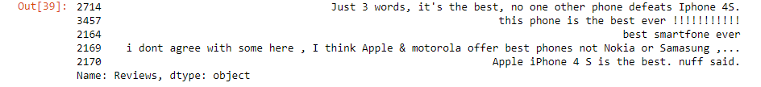
Top 5 Positive Review

Slide 8
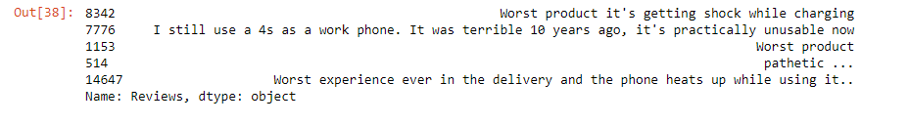
Top 5 Negative Review

Slide 9
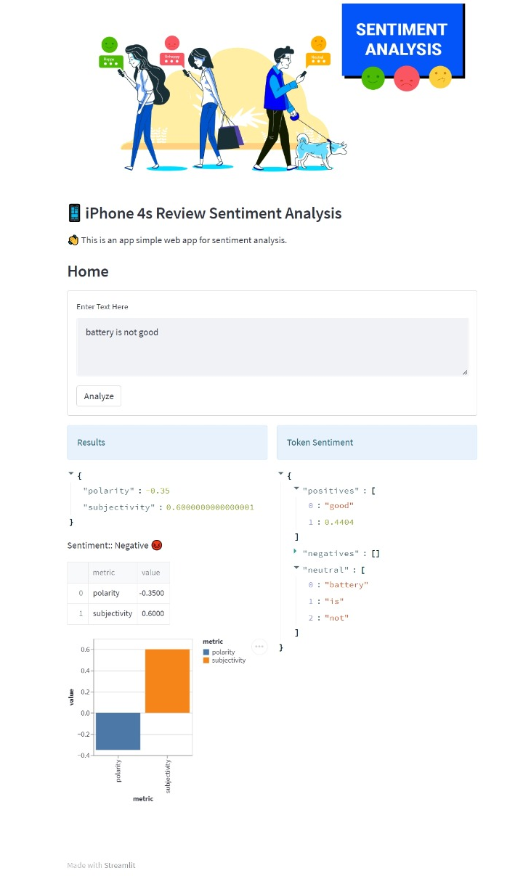
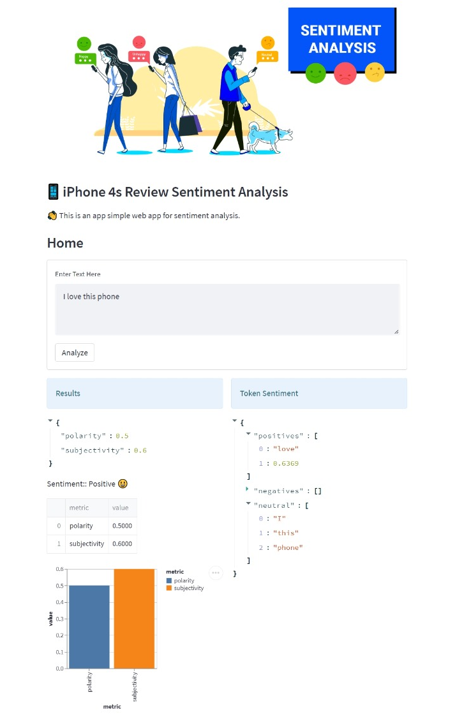
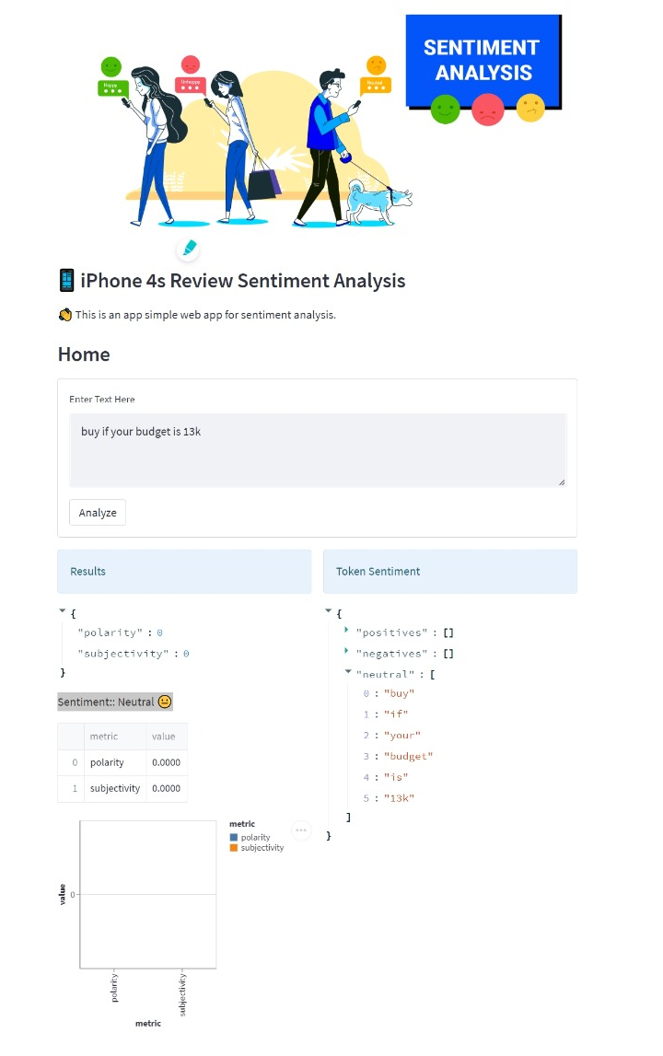

Slide 10
Learnings & Conclusion
Different phases of ML project life cycle for model development
Learnt application of various ML models
We have learnt about using spyder IDE and also learnt deployment using streamlit

Slide 11

Thank You

